Slide 1
Pittsburghese 101
Prakit Mohal
6/30/2023

Slide 2
Introduction
Pittsburghese is the term used for the words and pronunciation used in Pittsburgh
Many of the words used uniquely in Pittsburgh came from the Scots-Irish in the 1800’s
While many terms are used ironically it isn’t uncommon to hear people speak Pittsburghese naturally depending on where you go and who you interact with
Fun Fact: The Community College of Allegheny County has a course called “How to Lose Your Pittsburgh Accent”

Slide 3
Yinz
Arguably the most well known word
Comes from “you ones” from Ulster in Ireland and is used for a group of people, similar to y’all
Example: Where are yinz headed tonight?
The word “Yinzer” is used to describe someone from Pittsburgh, generally doing something stereotypically Pittsburgh (like wearing a Steelers jersey to church)
Can be used derogatorily or affectionately depending on the context
Example: My buddy is such a Yinzer he got us a 24 pack of Iron City for the party
Iron City is the local beer and it would be pronounced “Arn City”, we’ll get to that later

Slide 4
Other Words and Expressions
Gumband - Rubber band
Slippy - Slippery
Nebby - Nosy
Redd Up - Clean Up
Dippy Eggs - Eggs over easy
Kennywood’s Open - your fly is down
Kennywood is the name of the local amusement park
Jaggerbush - thorn bush
Jagoff - An irritating person, a jerk (used as a mild insult)
Example: That jagoff just cut me off!

Slide 5
Grammar Peculiarities
N’at - And so on
Example: Yinz ready to eat n’at?
Dropping the Infinitive
The words “to be” do not exist
My wife and I started dropping it because everyone we talked to at work did the same!
Example: Oh yea that bug needs fixed before we go live (instead of needs to be fixed or needs fixing)

Slide 6
Pronunciation
Steelers -> Stillers
Wash -> Worsh
Iron -> Arn
Downtown -> Dahntahn
Pittsburgh -> Picksburgh
Did you eat yet? -> Jeet yet?
Giant Eagle -> Gyn Iggle
If you try to guess how to pronounce French place names, good luck
Versailles: Ver Sails
Dubois: Du Boys
Duquesne: Du Quane (somehow this one didn’t get corrupted)

Slide 7
Accents in the real world
https://www.youtube.com/watch?v=yIeYGyV5NoQ&t=29s
Barry would be accurately affectionately described as a Yinzer because of
The accent
Wearing a Steelers beanie with a Pens jacket
The insistence that Pittsburgh is the best city despite his current circumstances

Slide 8
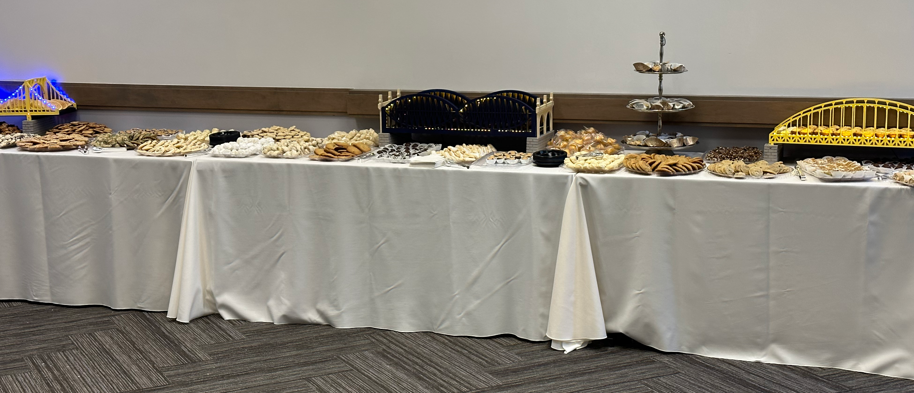
Cookie Tables
Every wedding MUST have a cookie table
Generally baked by family members and frozen in advance for the big day
Most people estimate 6-8 cookies per guest
Yes, the venues allow you to bring in outside food if it’s for the cookie table

Slide 9
Thank You!

